Slide 1
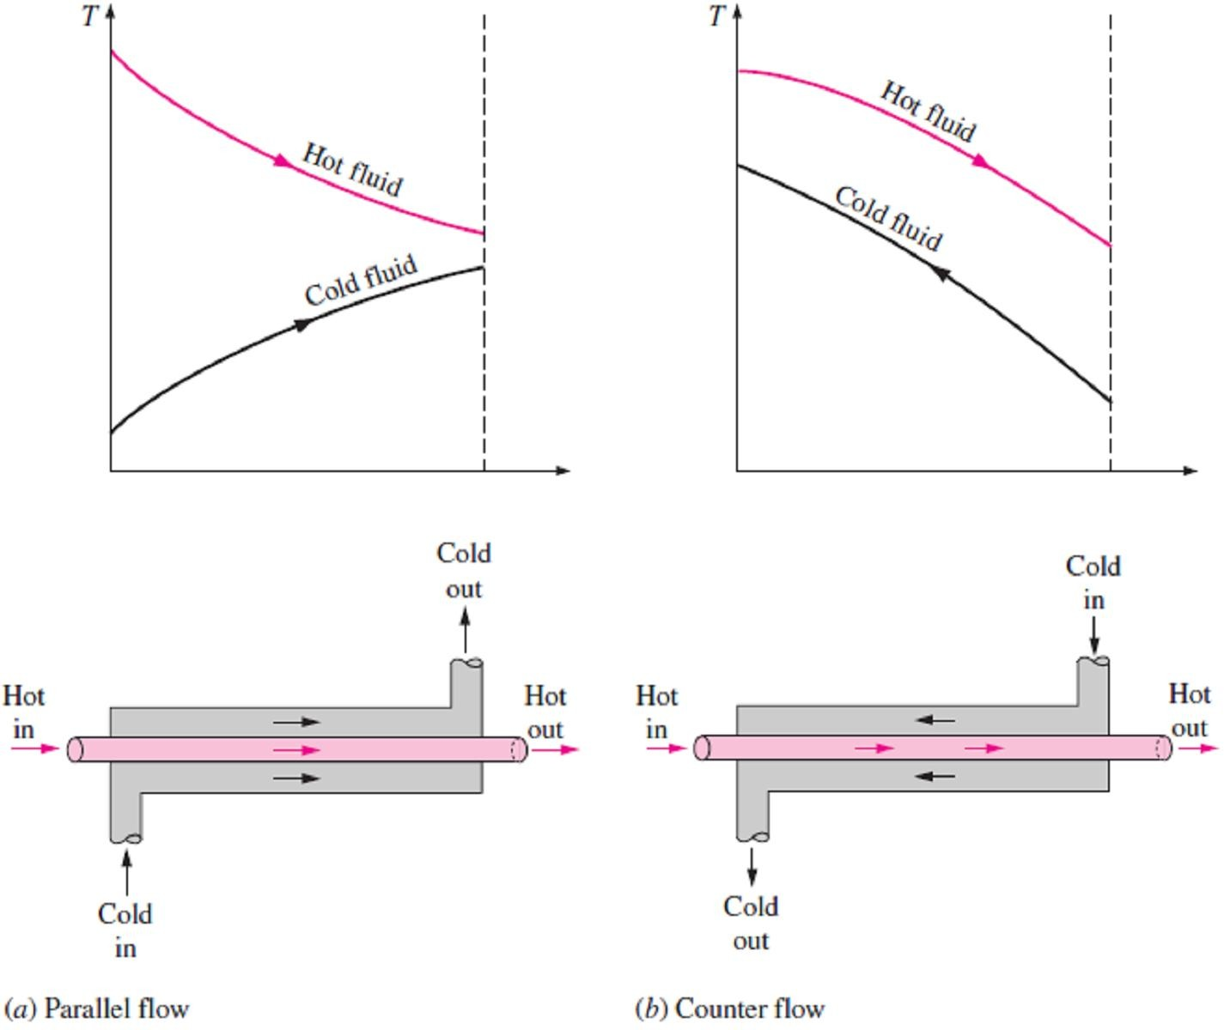
Chapter Seven Heat Exchangers
7.1- Introduction
Heat exchangers are devices that assist the exchange of heat between two fluids at different temperatures while keeping them from mixing with each other. Heat exchangers are commonly used in practice in a wide range of applications, from heating and air-conditioning systems in a household, to chemical processing and power production in large plants.
Note1- Heat exchangers differ from mixing chambers in that they do not allow the two fluids involved to mix.
Note2- Heat transfer in a heat exchanger usually involves convection in each fluid and conduction
through the wall separating the two fluids.
7.2- Types of Heat Exchangers
Different heat transfer applications require different types of hardware and different configurations of heat transfer equipment. The attempt to match the heat transfer hardware to the heat transfer requirements has resulted in various types of heat exchanger designs.
a- Double-Pipe Heat Exchanger
This type can be considered the simplest type of heat exchanger and consists of two concentric pipes of different diameters, as shown in Fig.(7.1), where the first fluid will flow through the smaller pipe while the other fluid will flow through the annular space between the two pipes.
Note- Two types of flow arrangement are possible in a double-pipe heat exchanger: in parallel flow, both the hot and cold fluids enter the heat exchanger at the same end and move in the same
direction. In counter flow, on the other hand, the hot and cold fluids enter the heat exchanger at
opposite ends and flow in opposite directions.
Fig.(7.1) Different flow regimes and associated temperature profiles in
a double-pipe heat exchanger
b- Compact Heat Exchanger
It is another type of heat exchanger, which is specifically designed to realize a large heat transfer surface area per unit volume, where the ratio of the heat transfer surface area of a heat exchanger to its volume is called the area density β. A heat exchanger with β > 700 m²/m³ (or 200 ft²/ft³) is classified as being compact. As example of compact type is the car radiator (β ≈ 1000 m²/m³).
Note1- The large surface area in compact heat exchangers is obtained by attaching closely spaced
thin plate or corrugated fins to the walls separating the two fluids.
Note2- Compact heat exchangers are commonly used in gas-to-gas and gas-to-liquid (or liquid-to- gas) heat exchangers to counteract the low heat transfer coefficient associated with gas flow with increased surface area.

Slide 2
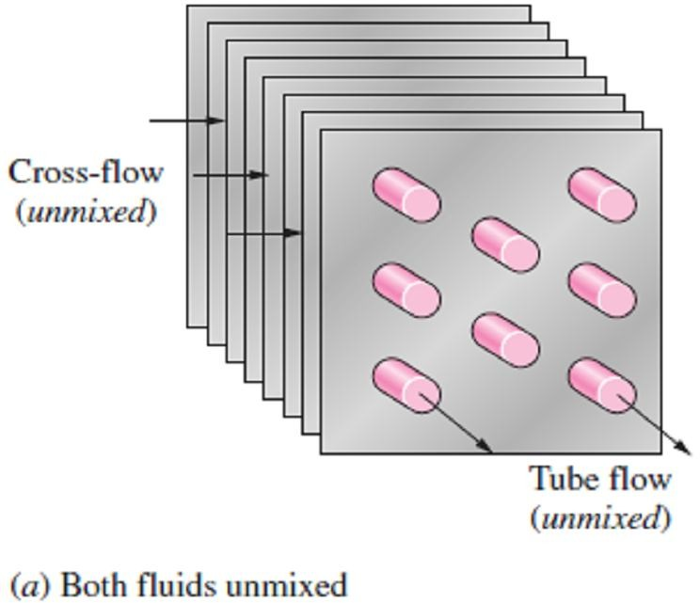
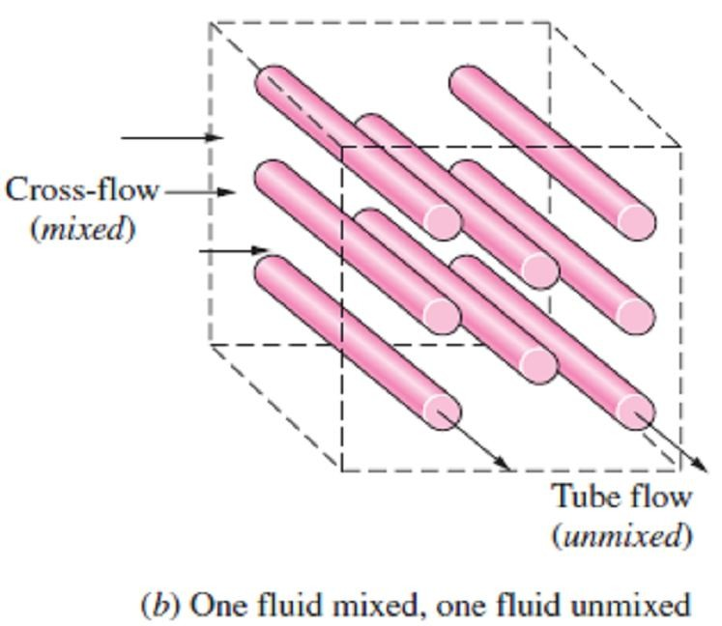
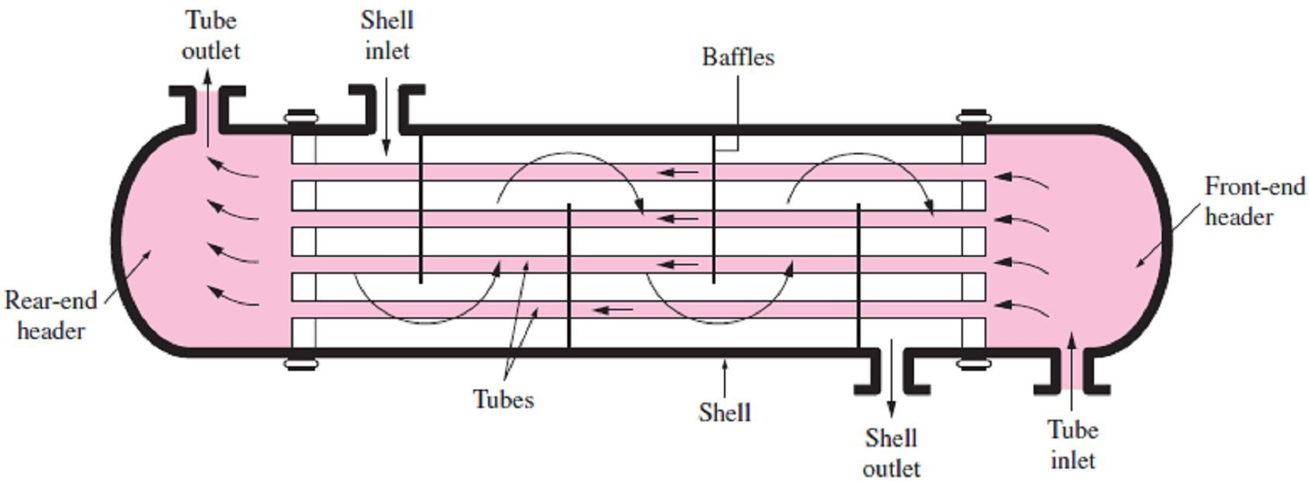
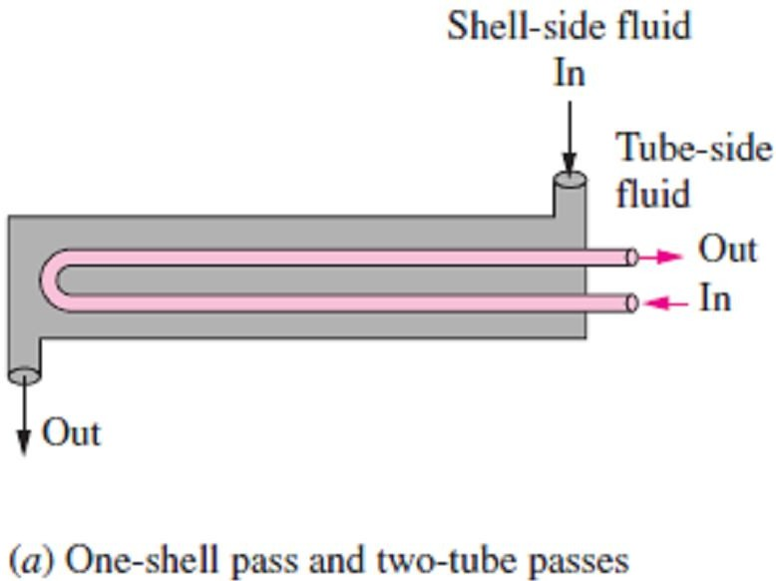
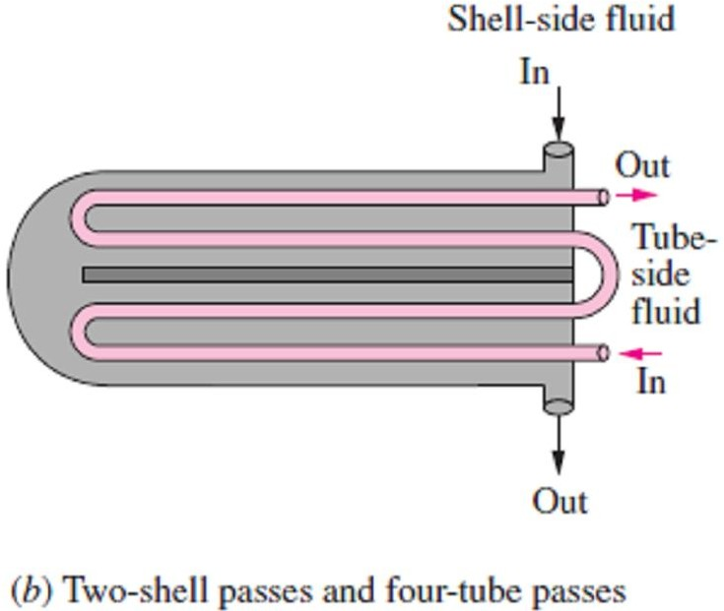
Chapter Seven
Heat Exchangers
Note3- In compact heat exchangers, the two fluids usually move perpendicular to each other, and such flow configuration is called cross-flow.
Note4- The cross-flow is further classified as unmixed and mixed flow, depending on the flow configuration, as shown in Fig(7.2). In (a) the cross-flow is said to be unmixed since the plate fins force the fluid to flow through a particular inter-fin spacing and prevent it from moving in the transverse direction (i.e., parallel to the tubes). The cross-flow in (b) is said to be mixed since the fluid now is free to move in the transverse direction.
c- Shell-and-Tube Heat Exchanger
It is the most common type of heat exchangers in industrial applications. As shown in Fig.(7.3), Shell-and-tube heat exchangers contain a large number of tubes (sometimes several hundred) packed in a shell. Heat transfer takes place as one fluid flows inside the tubes while the other fluid flows outside the tubes through the shell.
Note1- Despite their widespread use, shell-and-tube heat exchangers are not suitable for use in automotive and aircraft applications because of their relatively large size and weight. Note2- The tubes in a shell-and-tube heat exchanger open to
some large flow areas called headers at both ends of the shell, where the tube-side fluid accumulates before entering the tubes and after leaving them.
Fig.(7.2) Different flow configurations in cross-flow heat exchangers
Note3- Shell-and-tube heat exchangers are classified according to the number of shell and tube passes involved. Heat exchangers in which all the tubes make one U-turn in the shell, for example, are called one-shell-pass and two-tube-passes heat exchangers. Likewise, a heat exchanger that involves two passes in the shell and four passes in the tubes is called a two-shell-passes and four- tube-passes heat exchanger, as shown in Fig.(7.4).
Fig.(7.3) The schematic of a shell-and-tube heat exchanger (one-shell pass and one-tube pass)
Fig.(7.4) Multi-pass flow arrangements in shell-and- tube heat exchangers

Slide 3
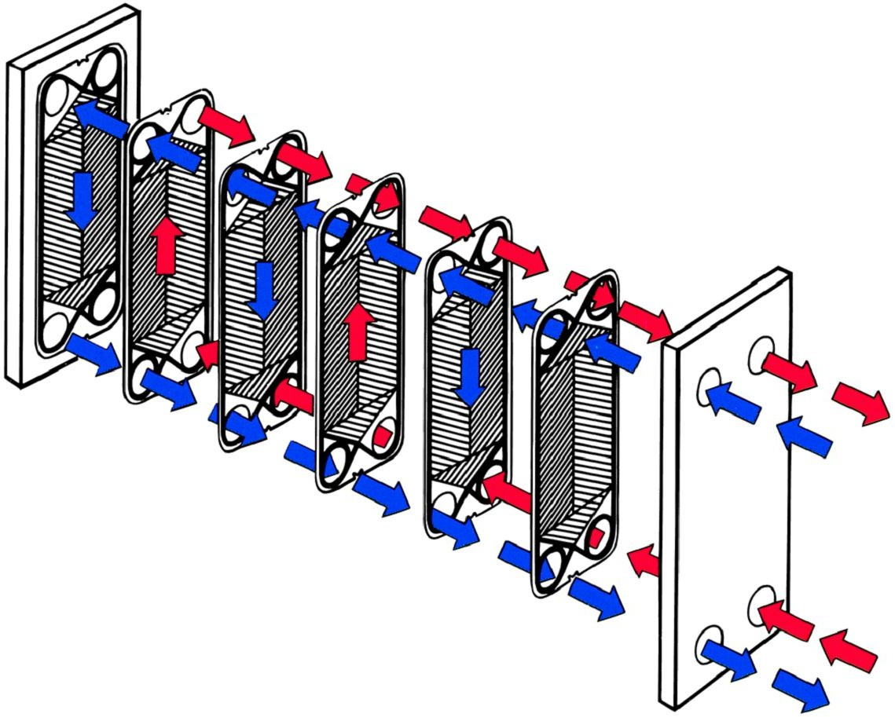
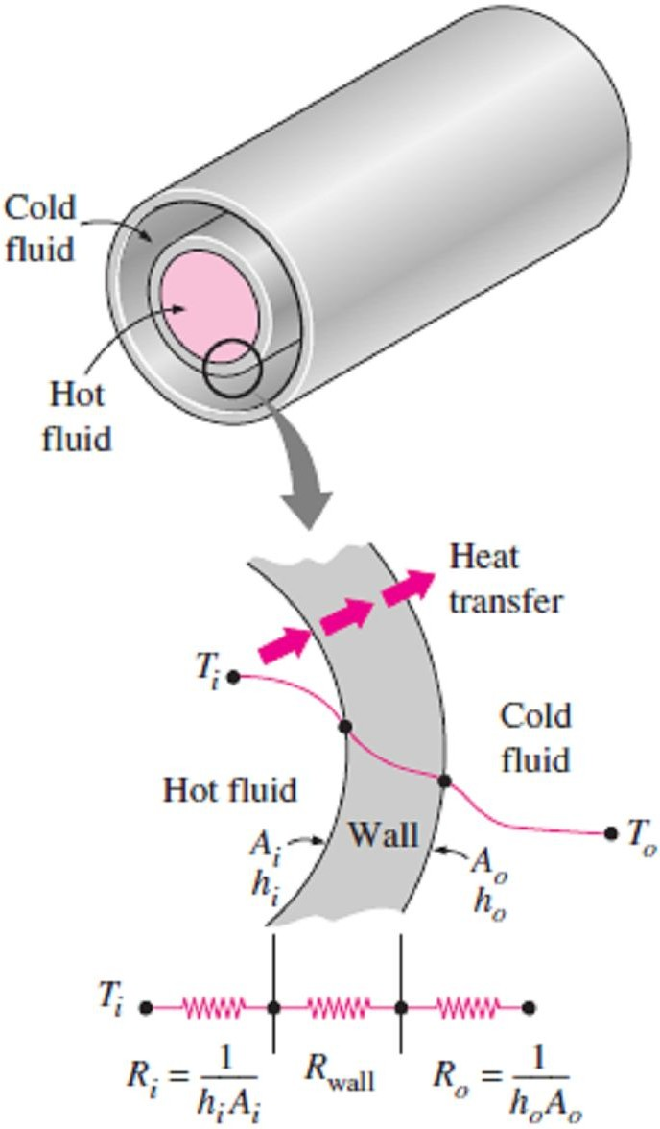
Chapter Seven
Heat Exchangers
d- Plate and Frame Heat Exchanger
It is an innovative type of heat exchanger that has found widespread use, where consists of a series of plates with corrugated flat flow passages as shown in Fig.(7.5). The hot and cold fluids flow in alternate passages, and thus, each cold fluid stream is surrounded by two hot fluid streams, resulting in very effective heat transfer. They are well suited for liquid-to-liquid heat exchange applications, provided that the hot and cold fluid streams are at about the same pressure.
Fig.(7.5) Flow Path of Plate and Frame Heat Exchanger
7.3- The Overall Heat Transfer Coefficient
A heat exchanger typically involves two flowing fluids separated by a solid wall. Heat is first transferred from the hot fluid to the wall by convection, through the wall by conduction, and from the wall to the cold fluid again by convection. The thermal resistance network associated with this heat transfer process involves two convection and one conduction resistances, as shown in Fig.(7.6). Here the subscripts i and o represent the inner and outer surfaces of the inner tube, respectively. For a double-pipe heat exchanger, we have A_{i}=πD_{i}L and A_{o}=πD_{o}L, and the thermal resistance of the tube wall in this case is;
R
wall
₌ ln ( D_{o} D_{i} )
☹(7.1)
2 kL
where k is the thermal conductivity of the wall material and L is the length of the tube. Then the total thermal resistance becomes;
1 ₊ ln (D_{o} D_{i} ) ₊ 1
^{R = R}total ^{= R}i ^{+ R}wall ^{+ R}o ⁼
h_{i} A_{i} 2 kL h A
o o
☹(7.2)
So, the rate of heat transfer between the two fluids can be written as follow;
Q = ^{ΔT} = UAΔT = U A ΔT = U A ΔT ☹(7.3)
Fig.(7.6) Thermal resistance network associated with heat transfer in a double-pipe heat exchanger
R
i i o o
where U is the overall heat transfer coefficient, whose unit is W/m² ·C°. By canceling ΔT from above equation, we have;
1 ₌ 1 ₌ 1 _{= R =} 1 ₊ ln (D_{o} D_{i} ) ₊ 1
UA_{s} U_{i} A_{i} U_{o} A_{o} h_{i} A_{i} 2 kL h_{o} A_{o}
☹(7.4)
Note1- It is clear from above equation that U_{i} ≠ U_{o} unless A_{i} = A_{o}. Therefore, the overall heat transfer coefficient U of a heat exchanger is meaningless unless the area on which it is based is specified. This is especially the case when one side of the tube wall is finned and the other side is not, since the surface area of the finned side is several times that of the unfinned side.
Note2- When the wall thickness of the tube is small and the thermal conductivity of the tube material is high, as is usually the case, the thermal resistance of the tube is negligible (R_{wall} ≈ 0) and the inner and outer surfaces of the tube are almost identical (A_{i} ≈ A_{o} ≈ A_{s}). Then Eq.(7.4) for the overall heat transfer coefficient will be simplified to;

Slide 4
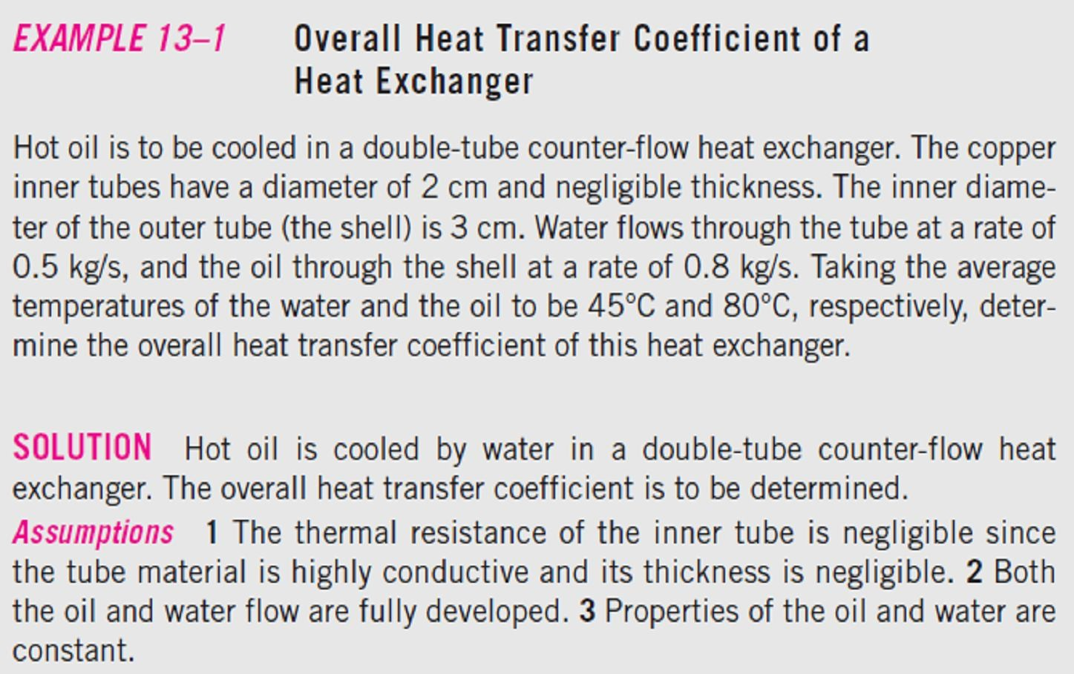
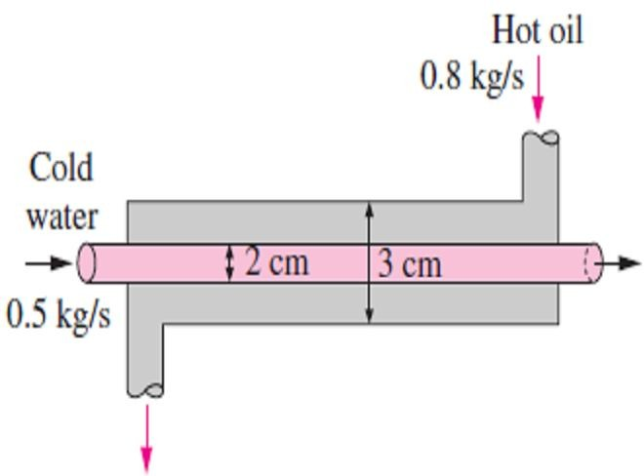
Chapter Seven
Heat Exchangers
1 ≈ 1 ₊ 1
U h_{i} h_{o}
where U ≈ U_{i} ≈ U_{o}.
☹(7.5)
Note3- The individual convection heat transfer coefficients inside and outside the tube, h_{i} and h_{o}, are determined using the convection relations discussed in the previous chapter.
Note4- When the tube is finned on one side in order to increase heat transfer, the total heat transfer surface area on the finned side becomes;
^{A}s ^{= A}total ^{= A}unfinned ^{+ A}fin
☹ (7.6.a)
where A_{fin} is the surface area of the fins and A_{unfinned} is the area of the unfinned portion of the tube surface.
Note5- For short fins of high thermal conductivity, we can use this total area in the convection resistance relation (R_{conv} = 1/ hA_{s}) since the fins in this case will be very nearly isothermal. Otherwise,
we should determine the effective surface area A_{s} from;
^{A}s ^{= A}unfinned ^{+ } fin ^{A}fin
☹(7.6.b)
where η_{fin} is the fin efficiency. This way, the temperature drop along the fins is considered. Note that
η_{fin} = 1 for isothermal fins, and thus Eq.(7.6.b) will be reduced to Eq. (7.6.a) in that case.
7.3.1- Fouling Factor
The performance of heat exchangers usually deteriorates with time as a result of accumulation of deposits on heat transfer surfaces. The layer of deposits represents an additional resistance to heat transfer and causes decreasing in the rate of transferred heat through the heat exchanger. The net effect of these accumulations on heat transfer is represented by a fouling factor R_{f}, which is a measure of the produced thermal resistance by fouling.
Note1- The fouling factor is obviously zero for a new heat exchanger and increases with time as the solid deposits build up on the heat exchanger surface.
Note2- The fouling factor depends on the operating temperature and the velocity of the fluids, as well
as the length of service. Fouling increases with increasing temperature and decreasing velocity.
Note3- The overall heat transfer coefficient relation given above is valid for clean surfaces and needs to be modified to account for the effects of fouling on both the inner and the outer surfaces of the tube. Note4- For an unfinned shell-and-tube heat exchanger, it can be expressed as;
1 ₌ 1 ₌ 1 _{= R =} 1 ₊ R_{f ,i +} ln (D_{o +} 1
D_{i} ) ₊ ^{R}f , o
☹(7.7)
UA_{s} U_{i} A_{i} U_{o} A_{o} h_{i} A_{i} A_{i} 2 kL A_{o} h_{o} A_{o}
where A_{i} = πD_{i} L and A_{o} = πD_{o} L are the areas of inner and outer surfaces, and R_{f, i} and R_{f, o} are the fouling factors at those surfaces.
7.1-
Fig.(7.7) Schematic for Example- 7.1

Slide 5
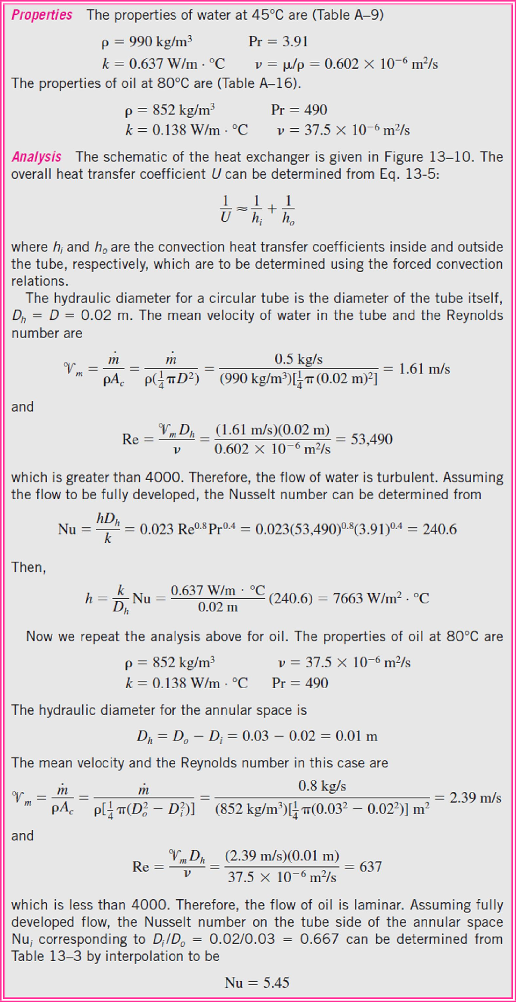
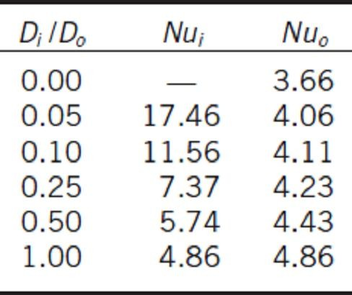
Chapter Seven
Heat Exchangers
Figure (7.7).
Eq.(7.5);
Table (7.1) Nusselt number
for fully developed laminar flow in a circular annulus with one surface insulated and the other isothermal
Table (7.1).

Slide 6
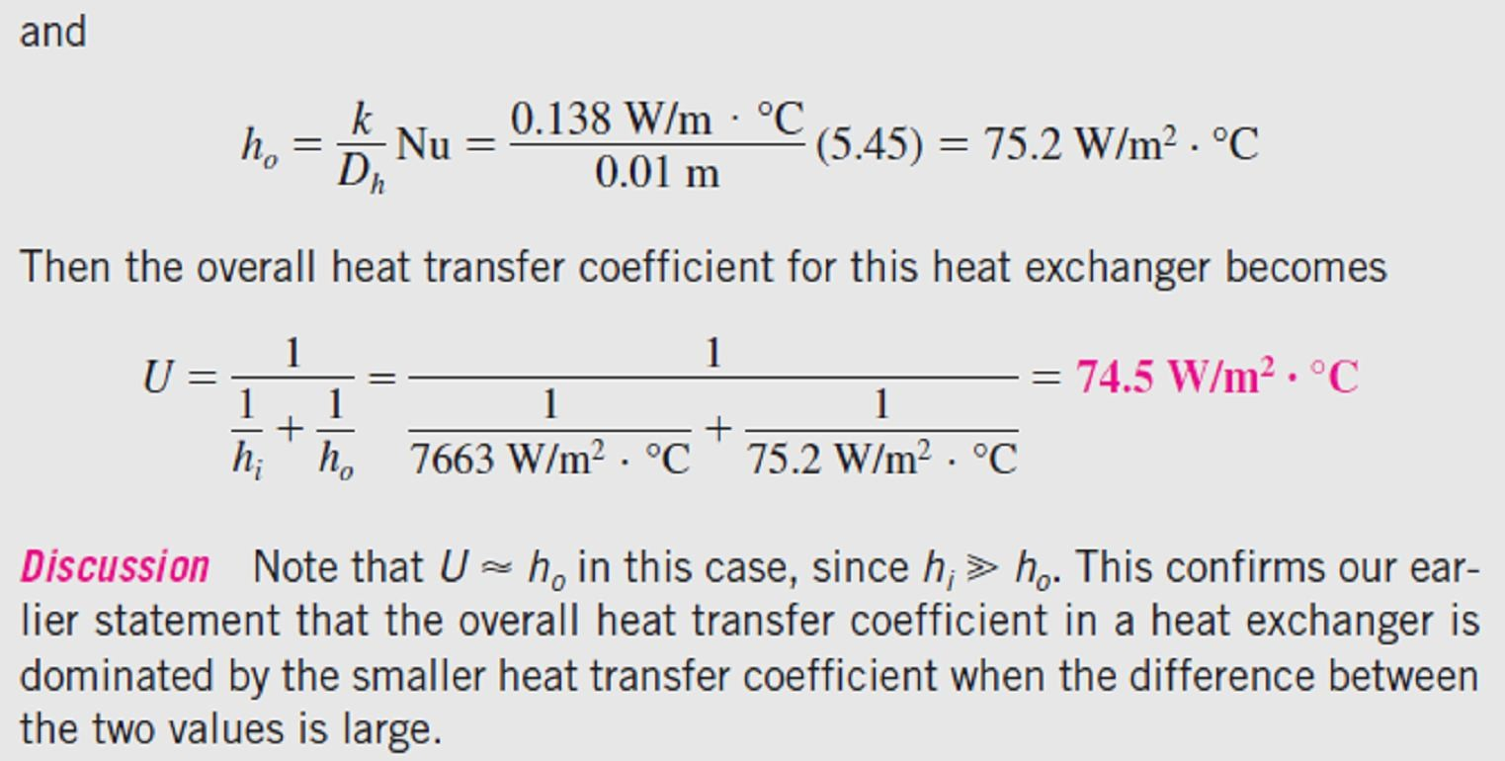
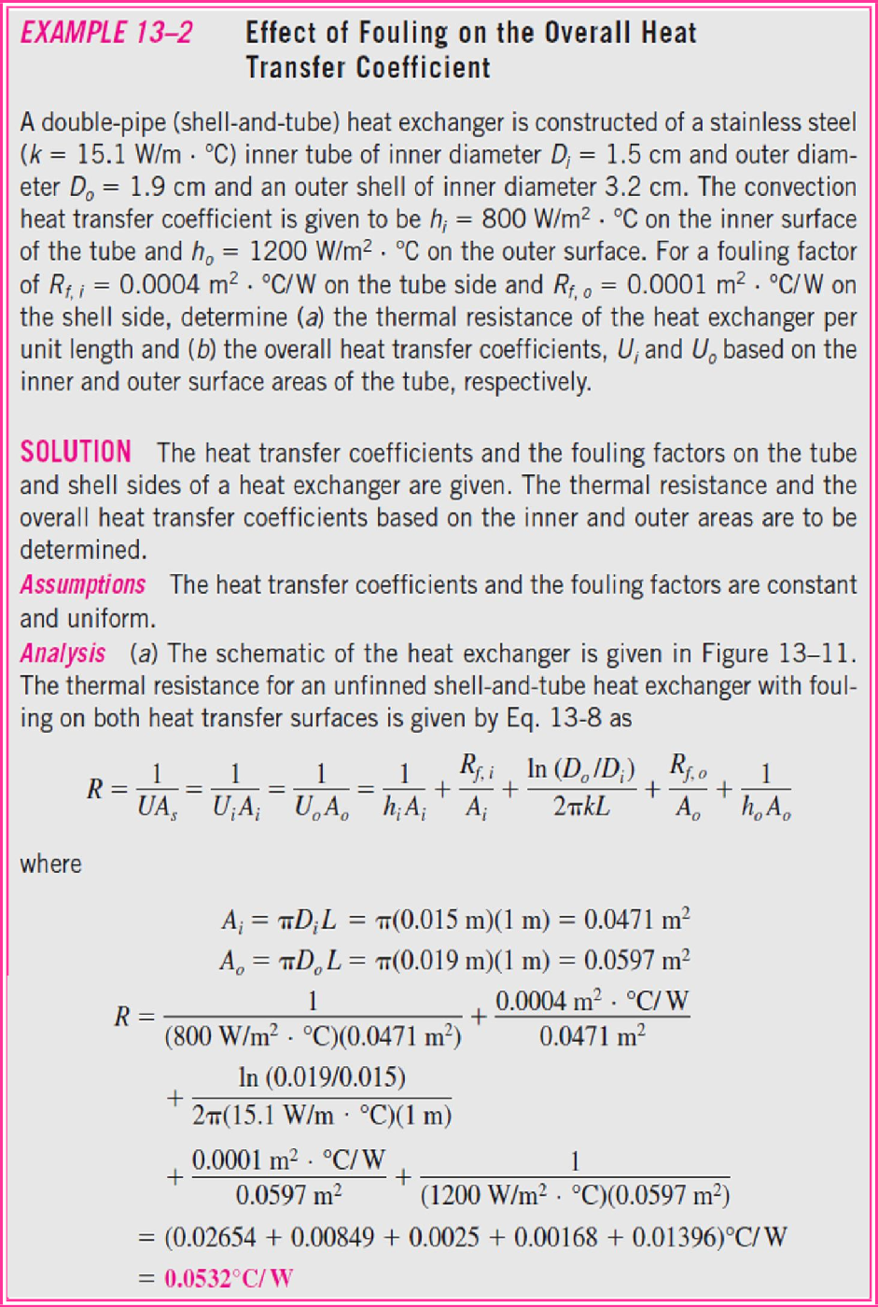
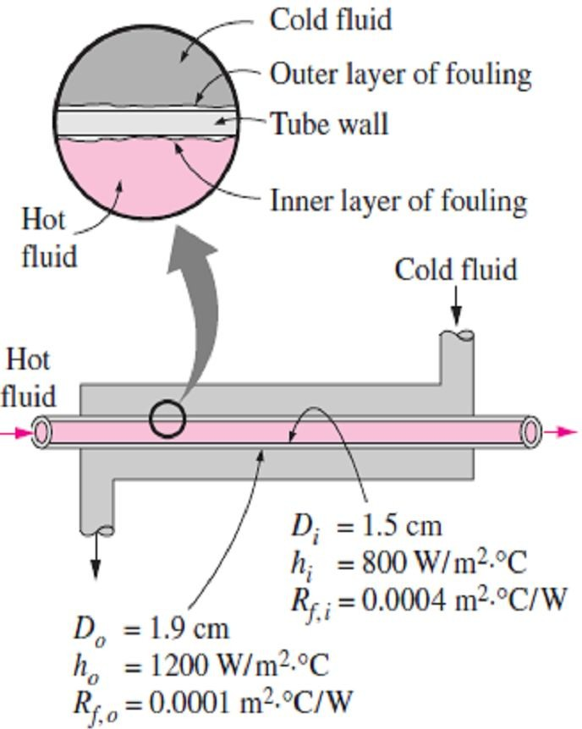
Chapter Seven
Heat Exchangers
7.2-
Figure (7.8).
Fig.(7.8) Schematic for Example- 7.2

Slide 7
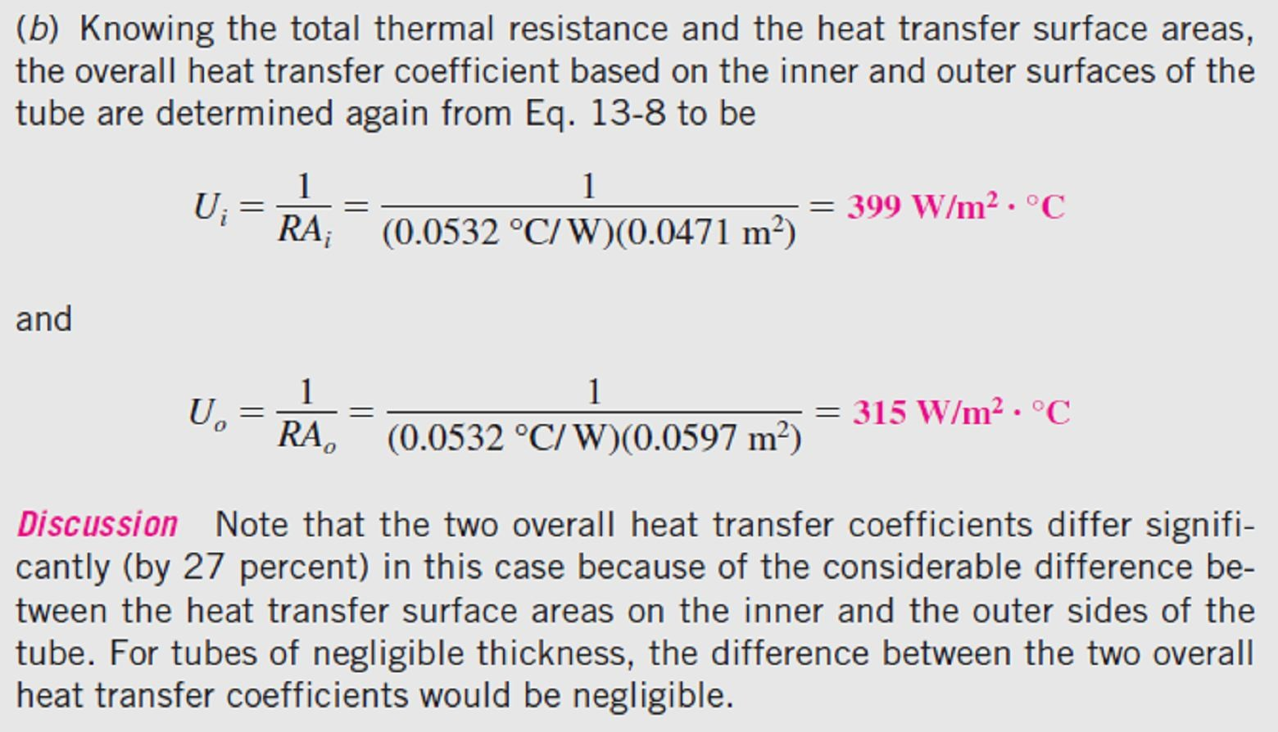
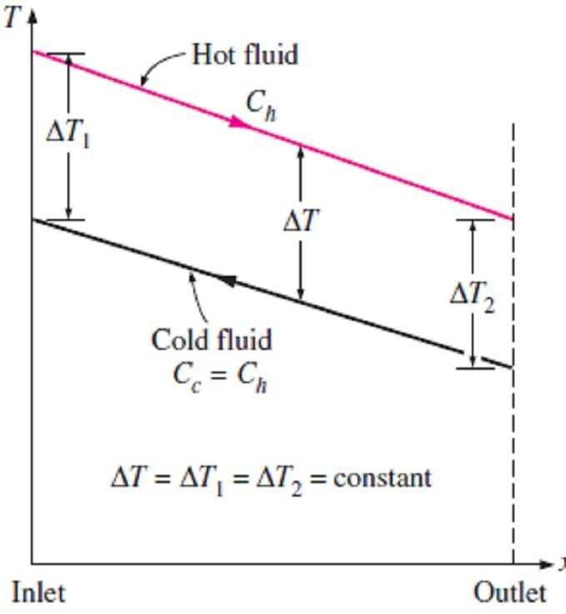
Chapter Seven
Heat Exchangers
7.4- Analysis of Heat Exchangers
In heat exchangers, we can consider the following assumptions;
Heat exchangers usually operate for long periods of time with no change in their operating conditions. Therefore, they can be modeled as steady-flow devices. As such, the mass flow rate of each fluid remains constant, and the fluid properties such as temperature and velocity at any inlet or outlet remain the same.
The outer surface of the heat exchanger is assumed to be perfectly insulated, so that there is no heat loss to the surrounding medium, and any heat transfer occurs between the two fluids only.
Under these assumptions, the first law of thermodynamics requires that the rate of heat transfer from the hot fluid be equal to the rate of heat transfer to the cold one. That is;
^{Q = m} c ^{C}p_{c} ^{(T}c, out ^{− T}c, in ⁾
^{Q = m} h ^{C}p_{h} ^{(T}h, in ^{− T}h, out ⁾
☹(7.8.a)
and;
☹(7.8.b)
where the subscripts c and h stand for cold and hot fluids, respectively, and;
m _{c} , m _{h} = mass flow rates
C_{pc} , C_{ph} = specific heats
T_{c, out} , T_{h, out} = outlet temperatures
T_{c, in} , T_{h, in} = inlet temperatures
Note1- In heat exchanger analysis, it is often convenient to combine the product of the mass flow rate and the specific heat of a fluid into
a single quantity. This quantity is called the heat capacity rate and is defined for the hot and cold fluid streams as;
C_{c} = m _{c} C_{pc} and C_{h} = m _{h} C_{p h} ☹(7.9)
With the definition of the heat capacity rate above, Eqs.[(7.8.a) & (7.8.b)] can also be expressed as;
^{Q = C}c ^{(T}c, out ^{− T}c, in ⁾
☹(7.10.a)
and;
☹(7.10.b)
^{Q = C}h ^{(T}h,in ^{− T}h, out ⁾
Fig.(7.9) Two fluids that have the same heat capacity rate experience the same temperature change in a well-insulated heat exchanger
Note2- The only time the temperature rise of a cold fluid is equal to the temperature drop of the hot fluid is when the heat capacity rates of the two fluids are equal to each other, as shown in Fig.(7.9).

Slide 8
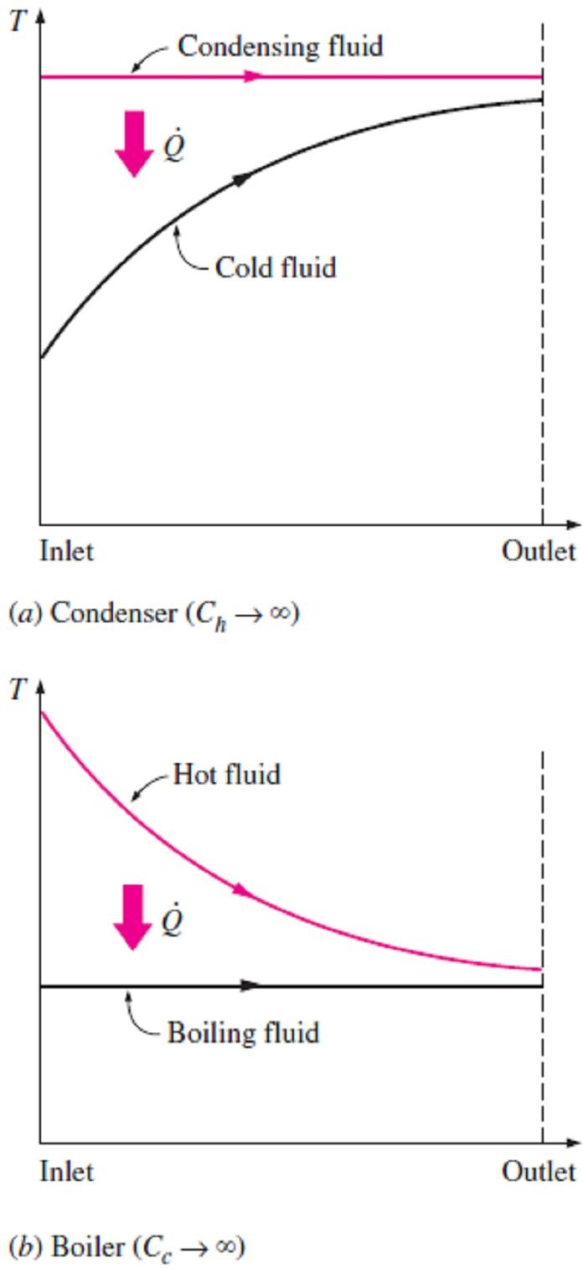
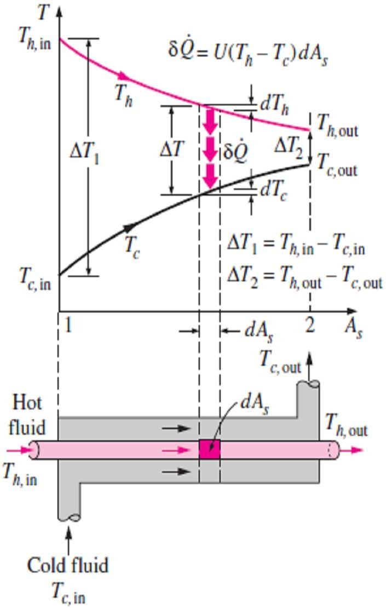
Chapter Seven
Heat Exchangers
Note3- Two special types of heat exchangers commonly used in practice are condensers and boilers. One of the fluids in a condenser or a boiler undergoes a phase-change process, and the rate of heat transfer is expressed as;
Q = m h_{fg} ☹(7.11)
where m is the rate of evaporation or condensation of the fluid and h_{fg} is the enthalpy of vaporization of the fluid at the specified temperature or pressure.
Note4- Any ordinary fluid absorbs or releases a large amount of heat at constant temperature during a phase-change process, as shown in Fig.(7.10). The heat capacity rate of a fluid during a
Fig.(6.12) Schematic for
Example- 6.2
phase-change process must approach infinity since the temperature
change is practically zero. That is, C = m C_{p} → ∞ when ΔT → 0, so that, the heat transfer rate Q = m C_{p} ΔT is a finite quantity.
Note5- The rate of heat transfer in a heat exchanger can also be expressed in an analogous manner to Newton’s law of cooling as;
Q = U A_{s} ΔT_{m} ☹(7.12)
where ΔT_{m} is an appropriate average temperature difference between the two fluids because the temperature difference ΔT between the hot and cold fluids, in general, is not constant and vary along the heat exchanger. So, the appropriate form of the mean
temperature difference between the two fluids is logarithmic in nature, and its determination will be presented in the next section.
7.5- The Log Mean Temperature Difference Method 7.5.1- Parallel-Flow Heat Exchangers
Fig.(7.10) Variation of fluid temperatures in a heat exchanger when one of the fluids condenses or boils
In order to develop a relation for the equivalent average temperature difference between the two fluids, consider the parallel-flow double-pipe heat exchanger shown in Fig.(7.11), where the outer surface of the heat exchanger is well insulated so that any heat transfer occurs just between the two fluids. Therefore, an energy balance on each fluid in a differential section of the heat exchanger can be expressed as;
Q = −m _{h} C_{ph} dT_{h} ☹(7.13.a)
Q = m _{c} C_{pc} dT_{c} ☹(7.13.b)
and;
That is, the rate of heat loss from the hot fluid at any section of a heat exchanger is equal to the rate of heat gain by the cold fluid in that section. Solving the equations above for dT_{h} and dT_{c} gives;
dT =
− Q
☹(7.14.a)
h
m C
and;
h p _{h}
dT =
Q
☹(7.14.b)
c
m C
Fig.(7.11) Variation of the fluid temperatures in a parallel-flow double-pipe heat exchanger
c p_{c}

Slide 9
Chapter Seven
Heat Exchangers
By subtracting Eq.(7.14.b) from Eq.(7.14.a), we get;
⎛
1 1
⎞
dT − dT = d (T − T ) = −Q
 ⎜
+
⎟
☹(7.15)
h c h c
⎜ m _{h} C_{p} m _{c} C_{p}
⎟
⎝
h
c ⎠
The rate of heat transfer in the differential section of the heat exchanger can also be expressed as;
Q = U (T_{h} − T_{c} )dA_{s} ☹(7.16)
Substituting this equation into Eq.(7.15) and rearranging gives;
d (T − T )
⎛ ⎞
1 1
h c
T_{h} − T_{c}
= −U dA
⎜
+
⎟
☹(7.17)
s
⎜ m _{h} C_{p} m _{c} C_{p}
⎟
⎝
h
c ⎠
Integrating from the inlet of the heat exchanger to its outlet, we obtain;
⎛ ⎞
^{⎛ T}h, out ^{− T}c, out ⎞
1 1
ln
⎜ ⎟
= −U A
⎜
+
⎟
☹(7.18)
⎜
T − T
⎟
s
⎜ m _{h} C_{p} m _{c} C_{p}
⎟
⎝ ⎠
⎝
c ⎠
h, in c, in
h
By using Eqs.[(7.8.a) & (7.8.b)], we have;
_{Q}
m _{h} C_{ph} = _{T} ☹(7.19.a)
T
and;
h, in h, out
m _{c} C_{pc} = _{T}
_{Q}
☹(7.19.b)
T
c, out c, in
Substituting both above equations into Eq.(7.18), gives;
^{⎛ T}h, out ^{− T}c, out ^{⎞ ⎛ T}h, in ^{− T}h, out ^{T}c, out ^{− T}c, in ⎞
ln⎜
T
⎟ = −U A_{s} ⎜ +
⎟
⎠
⎜
T
⎟
⎝
_{Q} _{Q}
⎝
h, in c, in
⎠
= − ^{U As} [(T − T − T )]
_{Q}
) − (T
☹(7.20.a)
h, in c, in h, out c, out
Or;
⎞
^{⎛ T}h, in ^{− T}c, in
U A_{s}
⎟ _{Q}
[(T − T ) − (T − T )]
h, in c, in h, out c, out
ln⎜
T
⎟ ₌
☹(7.20.b)
⎜
T
⎝
h, out c, out ⎠
Above equation can be written as follow;
)
ΔT₁ − ΔT₂

^{(T}h,in ^{− T}c,in ^{) − (T}h,out ^{− T}c,out
Q = U A
= U A
= U A ΔT
☹(7.21.a)
s
⎛ T − T ⎞
^{s} ln(ΔT ΔT )
s lm
ln⎜
h,in c,in
⎟
1 2
⎜ _{T}
− T
⎟
⎝
h,out c,out ⎠
Where;
ΔT₁ − ΔT₂
ΔT =
☹(7.21.b)
lm
ln(ΔT ΔT )
1 2
is the log mean temperature difference, which is the suitable form of the average temperature difference for use in the analysis of heat exchangers. Here ΔT₁ and ΔT₂ represent the temperature difference between the two fluids at the two ends (inlet and outlet) of the heat exchanger.
Note- It makes no difference which end of the heat exchanger is designated as the inlet or the outlet, as shown in Fig.(7.12.a).

Slide 10
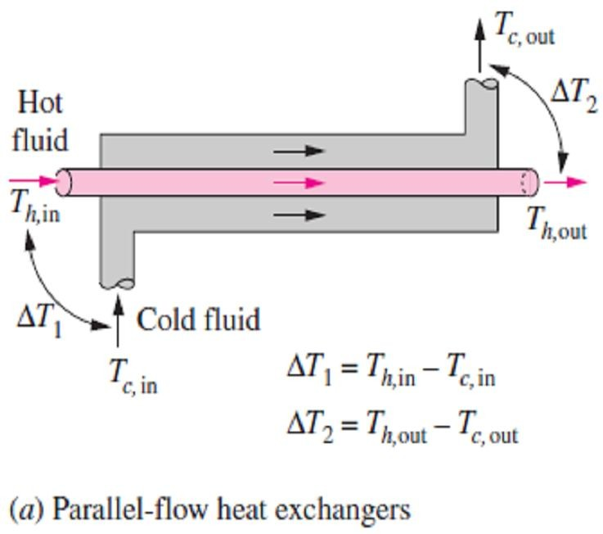
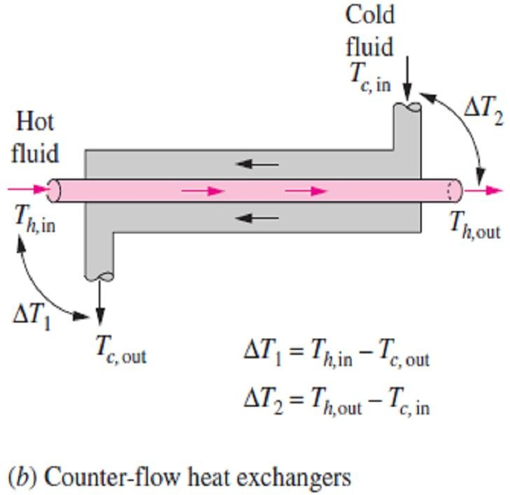
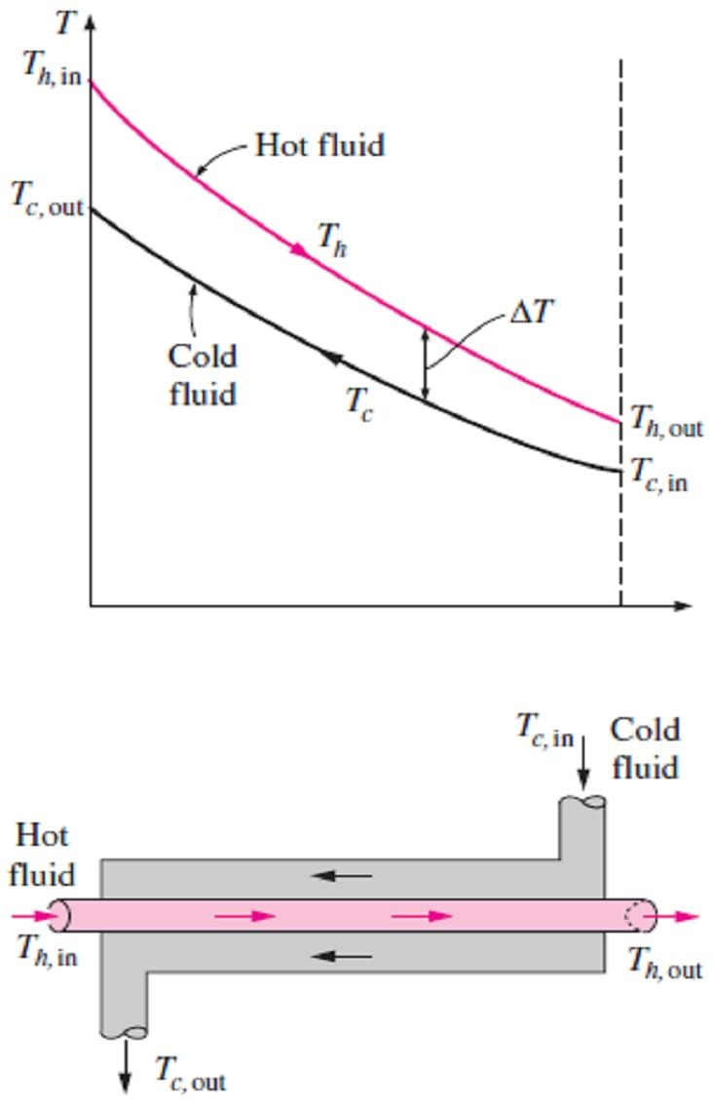
Chapter Seven
Heat Exchangers
Fig.(7.12) The ΔT₁ and ΔT₂ expressions in parallel-flow and counter-flow heat exchangers
7.5.2- Counter-Flow Heat Exchangers
For flow of hot and cold fluids in a counter-flow heat exchanger, we can summarize the following notes;
Note1- The relation above for the log mean temperature difference is developed using a parallel-flow heat exchanger,
but is also applicable to a counter-flow heat exchanger. But this time, ΔT₁ and ΔT₂ are expressed as shown in Fig.(7.12.b).
Note2- The hot and cold fluids enter the heat exchanger from opposite ends, and the outlet temperature of the cold fluid in
this case may exceed the outlet temperature of the hot fluid. In the limiting case, the cold fluid will be heated to the inlet
temperature of the hot fluid, as shown in Fig.(7.13).
Note3- In a counter-flow heat exchanger, the temperature difference between the hot and the cold fluids will remain constant along the heat exchanger when the heat capacity rates of the two fluids are equal (that is, ΔT= constant when C_{h} = C_{c}
or m _{h} C_{ph} = m _{c} C_{pc} ). Then we have ΔT₁ = ΔT₂, and the last log
mean temperature difference relation gives (ΔT_{lm} = 0/0), which is indeterminate. It can be shown by the application of
l’Hôpital’s rule that in this case we have ΔT_{lm} =ΔT₁ =ΔT₂, as
Fig.(7.13) The variation of the fluid temperatures in a counter-flow double-pipe heat exchanger
expected.
7.5.3- Multipass and Cross-Flow Heat Exchangers: (Use of a Correction Factor)
The log mean temperature difference ΔT_{lm} relation developed earlier is limited to parallel-flow and counter-flow heat exchangers only. Similar relations are also developed for cross-flow and multipass shell-and-tube heat exchangers, but the resulting expressions are too complicated because of the complex flow conditions. In such cases, it is convenient to relate the equivalent temperature difference to the log mean temperature difference relation for the counter-flow case as;
^{ΔT}lm ^{= F ΔT}lm, CF
☹(7.22)
where F is the correction factor, which depends on the geometry of the heat exchanger and the inlet and outlet temperatures of the hot and cold fluid streams.
Note1- The correction factor F for common cross-flow and shell-and-tube heat exchanger
configurations is given in Fig.(7.14) versus two temperature ratios P and R defined as;
_{P =} t₂ − t₁
☹(7.23.a) ,
and,
_{R =} T₁ − T₂ ₌ ^{(m C}p ⁾tube side
☹(7.23.b)
T₁ − t₁ t₂ − t₁
^{(m C}p ⁾shell side
where the subscripts 1 and 2 represent the inlet and outlet, respectively. Note that for a shell-and-tube heat exchanger, T and t represent the shell-side and tube-side temperatures, respectively.

Slide 11
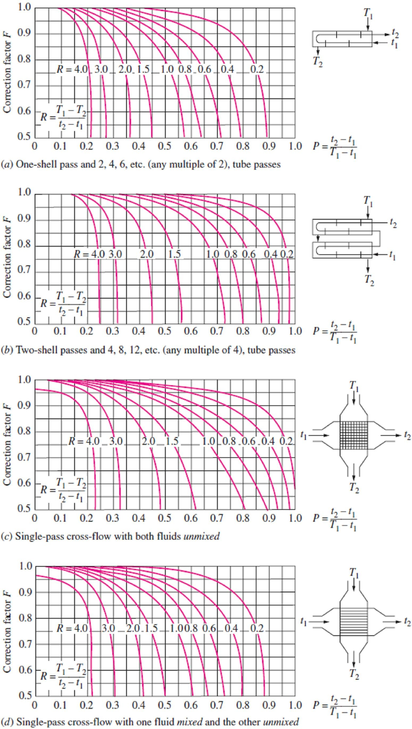
Chapter Seven Heat Exchangers
Note2- The value of P ranges from 0 to 1. The value of R, on the other hand, ranges from 0 to ∞, with
R = 0 corresponding to the phase-change (condensation or boiling) on the shell-side and R → ∞ to phase-change on the tube side. The correction factor is F = 1 for both of these limiting cases. Therefore, the correction factor for a condenser or boiler is F = 1, regardless of the configuration of the heat exchanger.
Fig.(7.14) Correction factor
(F) charts for common shell-and-tube and
cross-flow heat exchangers

Slide 12
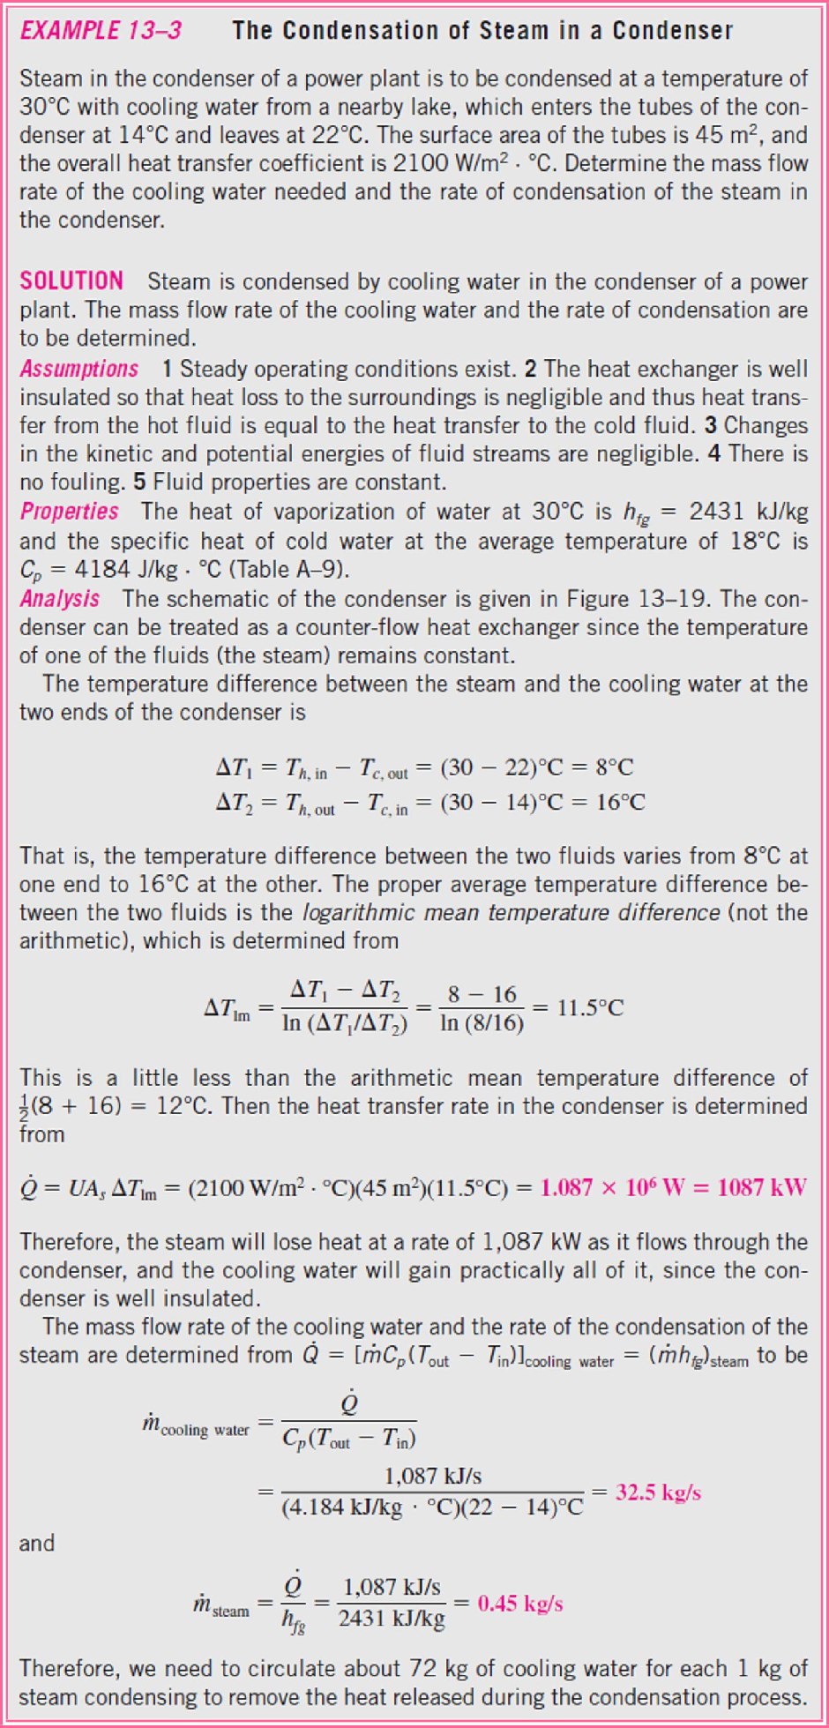
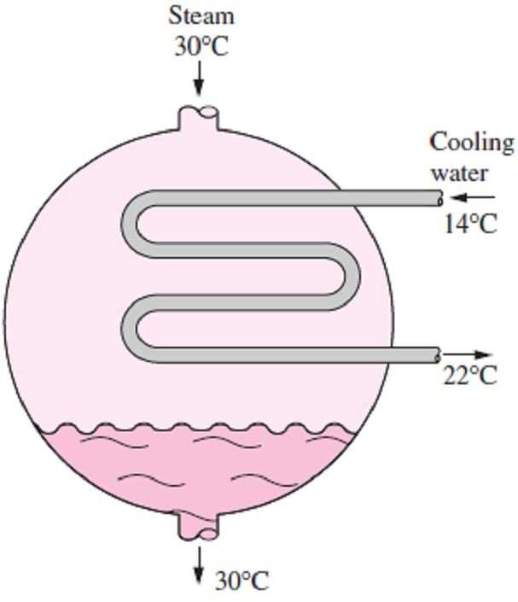
Chapter Seven
Heat Exchangers
7.3-
Fig.(7.15) Schematic for Example- 7.3
(7.15).

Slide 13
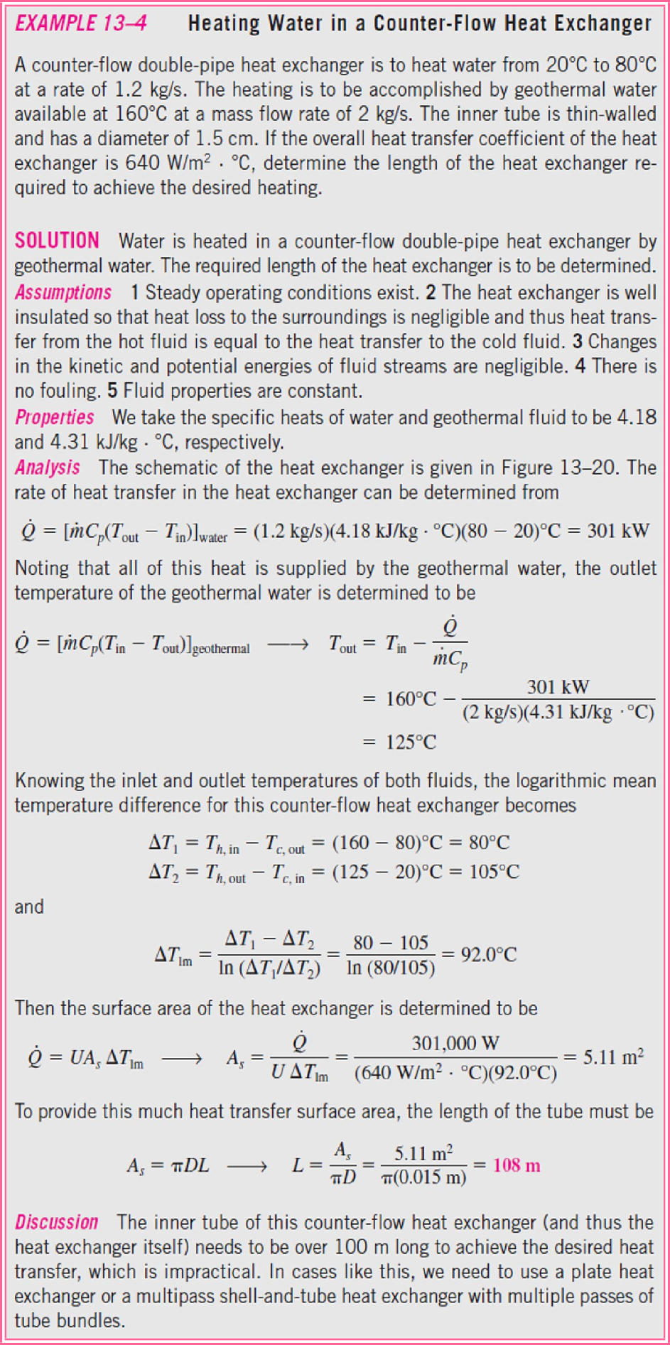
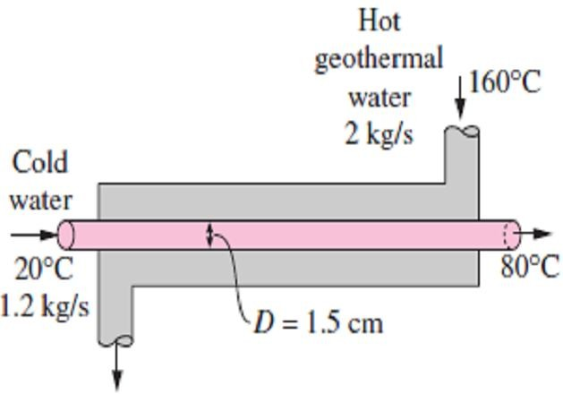
Chapter Seven
Heat Exchangers
7.4-
Fig.(7.16) Schematic for Example- 7.4
(7.16).

Slide 14
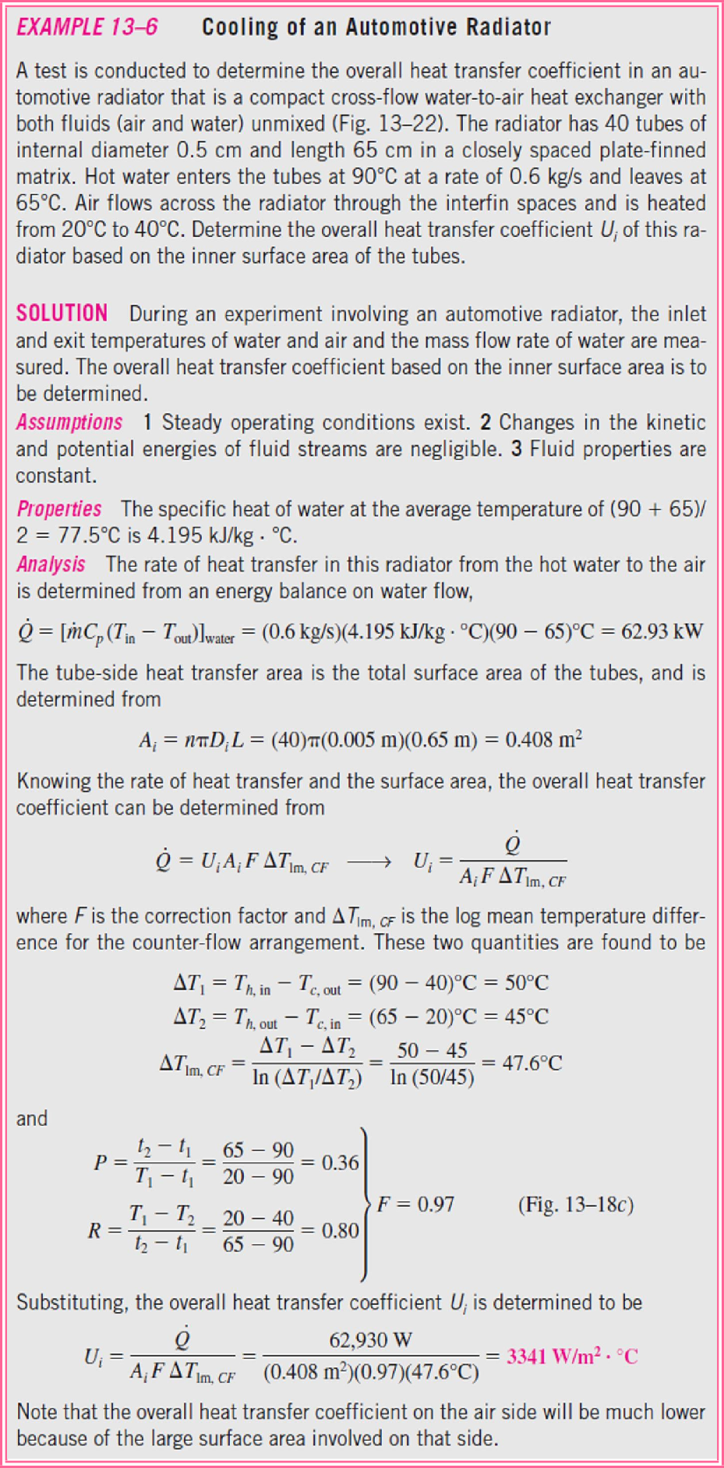
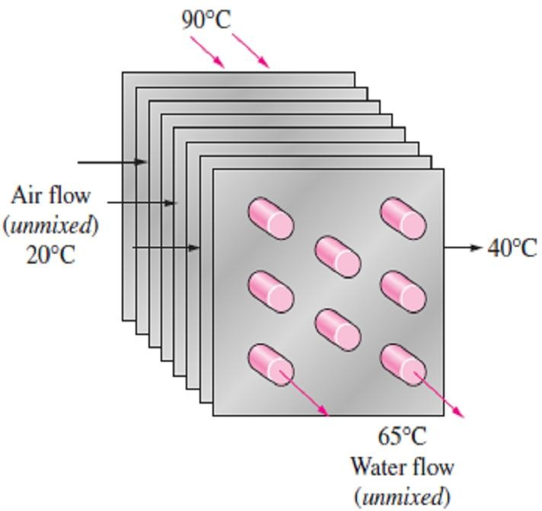
Chapter Seven
Heat Exchangers
7.5-
Figure (7.17).
Fig.(7.17) Schematic for Example- 7.5
Figure (7.14.c).

Slide 15
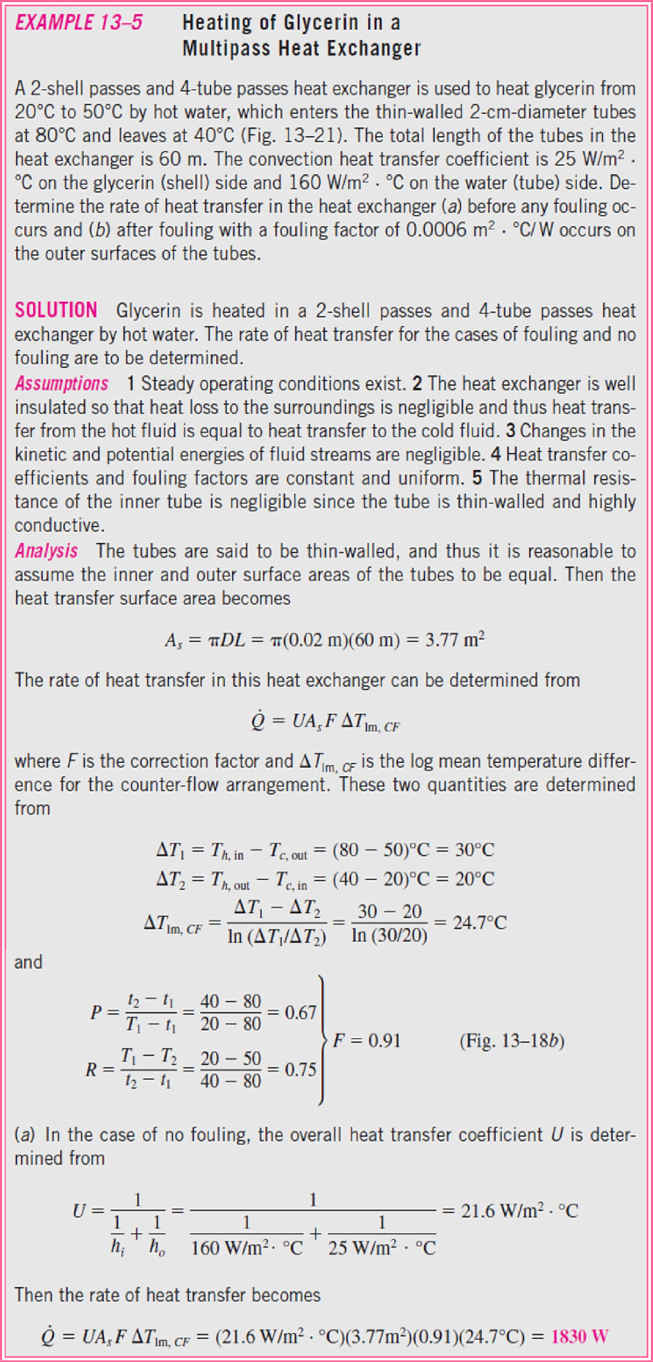
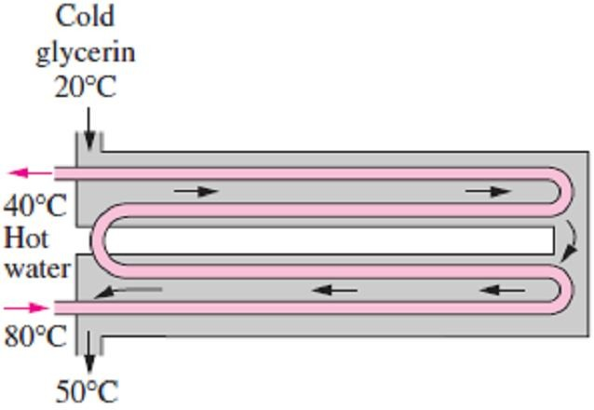
Chapter Seven
Heat Exchangers
7.6-
Figure (7.18).
Fig.(7.18) Schematic for Example- 7.6
Figure (7.14.b).

Slide 16
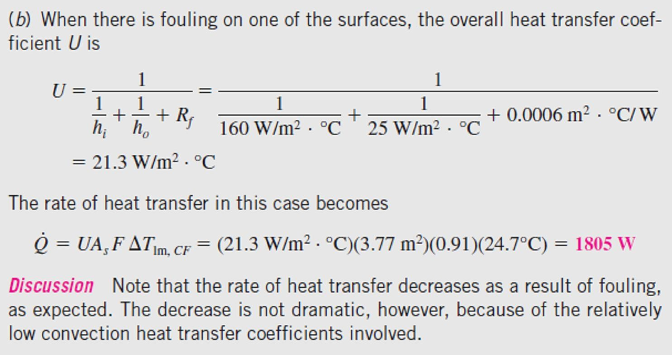
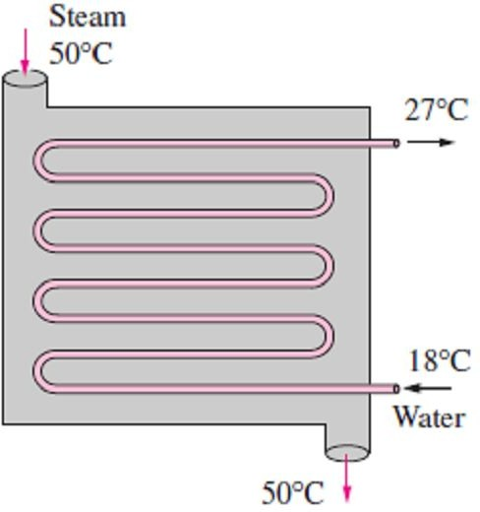
Chapter Seven
Heat Exchangers
PROBLEMS
7.1- A double-pipe heat exchanger is constructed of a copper (k = 380 W/m ·C°) inner tube of
Determine the overall heat transfer coefficient of this heat exchanger. Answer: 2020 W/m²· C°
internal diameter D_{i}= 1.2cm and external
7.5- Water at an average temperature of 140F° and an average velocity of 8 ft/s flows through a thin-walled 0.75in-diameter tube. The water is cooled by air that flows across the tube with a velocity of V∞ = 12 ft/sec at an average temperature of 80F°. Determine the overall heat transfer coefficient. Answer: 8.22 Btu/h·ft²·F°
diameter D_{o}=1.6cm and an outer tube of diameter
3.0cm. The convection heat transfer coefficient is reported to be h_{i}= 700 W/m² ·C° on the inner surface of the tube and ho = 1400 W/m² ·C° on its outer surface. For a fouling factor R_{f, i}= 0.0005
m²·C°/W on the tube side and 0.0002
Rf,o=
m²·C°/W on the shell side, determine (a) the thermal resistance of the heat exchanger per unit
7.6- Steam in the condenser of a steam power plant is to be condensed at a temperature of 50C° (h_{fg} = 2305 kJ/kg) with cooling water (C_{p} = 4180 J/kg ·C°) from a nearby lake, which enters the tubes of the condenser at 18C° and leaves at 27C°. The surface area of the tubes is 58m², and the overall heat transfer coefficient is 2400 W/m²
C°. Determine the mass flow rate of the cooling water needed and the rate of condensation of the steam in the condenser.
Answers: 101 kg/s, 1.65 kg/s
length and (b) the overall heat transfer
coefficients U_{i} and U_{o} based on the inner and
outer surface areas of the tube, respectively. Answers:0.0837C°/W, 317W/m²·C°, 238W/m²·C° 7.2- Water at an average temperature of 107C° and an average velocity of 3.5 m/s flows through a 5m-long stainless steel tube (k =14.2 W/m · C°) in a boiler. The inner and outer diameters of the tube are D_{i} = 1.0cm and D_{o} = 1.4cm, respectively. If the convection heat transfer coefficient at the outer surface of the tube where boiling is taking place is h_{o}= 8400 W/m² ·C°, determine the overall heat transfer coefficient U_{i} of this boiler based on the inner surface area of the tube.
Answer: 4055 W/m²·C° 7.3- Repeat Prob.(7.2), assuming a fouling factor R_{f, i} = 0.0005m² ·C°/W on the inner surface of the
tube. Answer: 1337 W/m²·C°
7.4- A long thin-walled double-pipe heat exchanger with tube and shell diameters of 1.0cm and 2.5cm, respectively, is used to condense refrigerant 134a by water at 20C°. The refrigerant flows through the tube, with a convection heat transfer coefficient of h_{i} = 5000 W/m² ·C°. Water flows through the shell at a rate of 0.3 kg/s.
7.7- A double-pipe parallel-flow heat exchanger is to heat water (C_{p} = 4180 J/kg ·C°) from 25C° to 60C° at a rate of 0.2kg/s. The heating is to be accomplished by geothermal water (C_{p} = 4310 J/kg ·C°) available at 140C° at a mass flow rate of 0.3kg/s. The inner tube is thin-walled and has a diameter of 0.8cm. If the

Slide 17
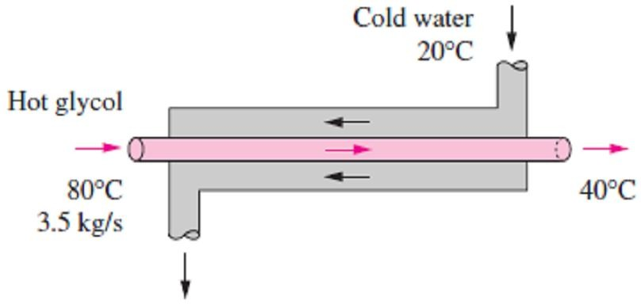
Chapter Seven
Heat Exchangers
overall heat transfer coefficient of the heat exchanger is 550 W/m² ·C°, determine the length of the heat exchanger required to achieve the desired heating. Answer: 25.5m
7.8- A 1-shell-pass and 8-tube-passes heat exchanger is used to heat glycerin (C_{p} = 0.60 Btu
/lbm ·F°) from 65F° to 140F° by hot water (C_{p} =
1.0 Btu /lbm ·F°) that enters the thin walled 0.5in-diameter tubes at 175F° and leaves at 120F°. The total length of the tubes in the heat exchanger is 500ft. The convection heat transfer coefficient is 4Btu/h·ft²·F° on the glycerin (shell) side and 50 Btu/h·ft²·F° on the water (tube) side. Determine the rate of heat transfer in the heat exchanger (a) before any fouling occurs and (b) after fouling with a fouling factor of 0.002 h·ft²· F°/Btu occurs on the outer surfaces of the tubes.
Answers: 60,000 Btu/h, 59,680 Btu/h
7.11- Consider a water-to-water double-pipe heat exchanger whose flow arrangement is not known. The temperature measurements indicate that the cold water enters at 20C° and leaves at 50C°, while the hot water enters at 80C° and leaves at 45C°. Do you think this is a parallel-flow or counter-flow heat exchanger? Explain.
7.12 Cold water (C_{p} = 4180 J/kg ·C°) leading to a shower enters a thin-walled double-pipe counter- flow heat exchanger at 15C° at a rate of 0.25 kg/s and is heated to 45C° by hot water (C_{p}= 4190 J/kg ·C°) that enters at 100C° at a rate of 3 kg/s. If the overall heat transfer coefficient is 1210 W/m² ·C°, determine the rate of heat transfer and the heat transfer surface area of the heat exchanger. Answers: 31.35 kW, 0.382m²
7.13- Glycerin (C_{p} = 2400 J/kg ·C°) at 20C° and
0.3 kg/s is to be heated by ethylene glycol (C_{p} = 2500 J/kg ·C°) at 60C° in a thin-walled double-
7.9- A test is conducted to determine the overall heat transfer coefficient in a shell-and-tube oil-to- water heat exchanger that has 24 tubes of internal diameter 1.2cm and length 2m in a single shell. Cold water (C_{p}= 4180J/kg·C°) enters the tubes at 20C° at a rate of 5 kg/s and leaves at 55C°. Oil (C_{p} = 2150 J/kg ·C°) flows through the shell and is cooled from 120C° to 45C°. Determine the overall heat transfer coefficient U_{i} of this heat exchanger based on the inner surface area of the tubes. Answer: 13.9 kW/m² ·C°
pipe parallel-flow heat exchanger. The
temperature difference between the two fluids is
15C° at the outlet of the heat exchanger. If the
overall heat transfer coefficient is 240 W/m² ·C° and the heat transfer surface area is 3.2m², determine (a) the rate of heat transfer, (b) the outlet temperature of the glycerin, and (c) the mass flow rate of the ethylene glycol.
Answers: 19.58 kW, 47.2C°, 3.56 kg/s
7.10- A double-pipe counter-flow heat exchanger is to cool ethylene glycol (C_{p} = 2560 J/kg ·C°) flowing at a rate of 3.5 kg/s from 80C° to 40C° by water (C_{p} = 4180 J/kg ·C°) that enters at 20C° and leaves at 55C°. The overall heat transfer coefficient based on the inner surface area of the tube is 250 W/m² ·C°. Determine (a) the rate of heat transfer, (b) the mass flow rate of water, and
(c) the heat transfer surface area on the inner side of the tube.
Answers: 358.4 kW, 2.45 kg/s, 64.0m²
7.14- Air (C_{p} = 1005 J/kg ·C°) is to be preheated by hot exhaust gases in a cross-flow heat exchanger before it enters the furnace. Air enters the heat exchanger at 95kPa and 20C° at a rate of
0.8 m³/s. The combustion gases (C_{p} = 1100 J/kg
C°) enter at 180C° at a rate of 1.1 kg/s and leave at 95C°. The product of the overall heat transfer coefficient and the heat transfer surface area is UA = 1200 W/C°. Assuming both fluids to be unmixed, determine the rate of heat transfer and the outlet temperature of the air.
Answers: 103 kW, 133C° 7.15- A shell-and-tube heat exchanger with 2- shell passes and 12-tube passes is used to heat water (C_{p} = 4180 J/kg·C°) in the tubes from 20C° to 70C° at a rate of 4.5 kg/s. Heat is supplied by hot oil (C_{p} = 2300 J/kg·C°) that enters the shell side at 170C° at a rate of 10 kg/s. For a tube-side overall heat transfer coefficient of 600 W/m² ·C°, determine the heat transfer surface area on the tube side. Answer: 15m²

Slide 18
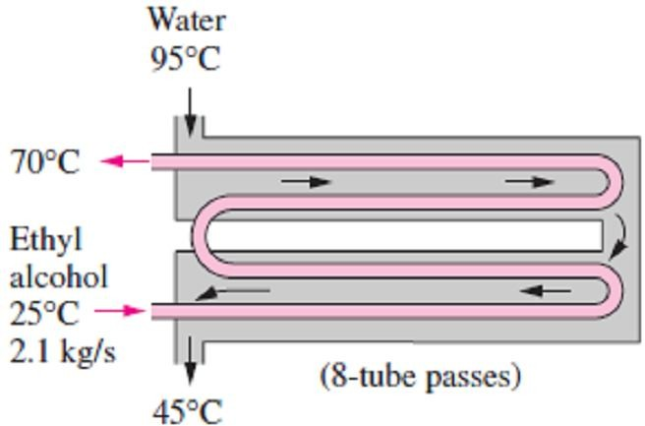
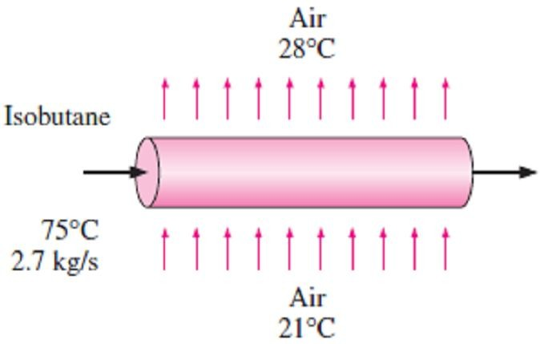
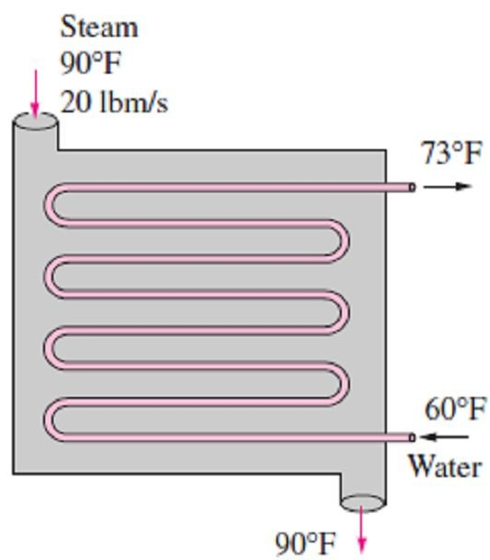
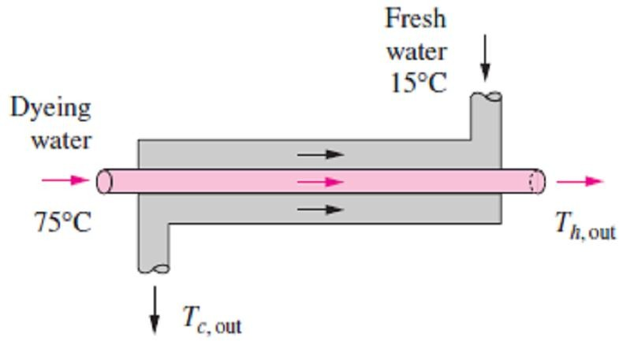
Chapter Seven
Heat Exchangers
7.16- A shell-and-tube heat exchanger with 2- shell passes and 8-tube passes is used to heat ethyl alcohol (C_{p} = 2670 J/kg ·C°) in the tubes from 25C° to 70C° at a rate of 2.1 kg/s. The heating is to be done by water (C_{p} = 4190 J/kg
C°) that enters the shell side at 95C° and leaves at 45C°. If the overall heat transfer coefficient is
950 W/m² ·C°, determine the heat transfer surface
area of the heat exchanger. Answers: 15.4m²
7.19- In a binary geothermal power plant, the working fluid iso-butane is to be condensed by air in a condenser at 75C° (h_{fg} _ 255.7 kJ/kg) at a rate of 2.7 kg/s. Air enters the condenser at 21Cº and leaves at 28Cº. The heat transfer surface area based on the iso-butane side is 24m². Determine the mass flow rate of air and the overall heat transfer coefficient.
Answers: 98.14 kg/s, 571 W/m² ·C°
7.17- Steam is to be condensed on the shell side of a 1-shell-pass and 8-tube-passes condenser, with 50 tubes in each pass at 90F° (h_{fg} = 1043 Btu/lbm). Cooling water (C_{p}=1.0 Btu/lbm ·F°) enters the tubes at 60F° and leaves at 73F°. The tubes are thin-walled and have a diameter of 0.75in and length of 5ft per pass. If the overall heat transfer coefficient is 600 Btu/h ·ft² ·F°, find
(a) the rate of heat transfer, (b) the rate of condensation of steam, and (c) the mass flow rate of cold water. Answers: 5.396×10⁶ Btu/h,
1.44 lbm/s, 115 lbm/s
7.20- Hot exhaust gases of a stationary diesel engine are to be used to generate steam in an evaporator. Exhaust gases (C_{p} = 1051 J/kg ·Cº) enter the heat exchanger at 550Cº at a rate of 0.25 kg/s while water enters as saturated liquid and evaporates at 200Cº (h_{fg} = 1941 kJ/kg). The heat transfer surface area of the heat exchanger based on water side is 0.5m² and overall heat transfer coefficient is 1780 W/m² ·Cº. Determine the rate of heat transfer, the exit temperature of exhaust gases, and the rate of evaporation of water.
Answers: 88.85 kW, 211.8C°, 0.0458 kg/s
7.21- In a textile manufacturing plant, the waste dyeing water (C_{p} = 4295 J/g ·Cº) at 75C° is to be used to preheat fresh water (C_{p} = 4180 J/kg ·Cº) at 15Cº at the same flow rate in a double-pipe counter-flow heat exchanger. The heat transfer surface area of the heat exchanger is 1.65m² and the overall heat transfer coefficient is 625 W/m²
Cº. If the rate of heat transfer in the heat exchanger is 35kW, determine the outlet temperature and the mass flow rate of each fluid
7.18- A shell-and-tube heat exchanger with 1- shell pass and 20-tube passes is used to heat glycerin (C_{p} = 2480 J/kg ·C°) in the shell, with hot water in the tubes. The tubes are thin-walled and have a diameter of 1.5cm and length of 2m per pass. The water enters the tubes at 100C° at a rate of 5 kg/s and leaves at 55C°. The glycerin enters the shell at 15C° and leaves at 55C°. Determine the mass flow rate of the glycerin and the overall heat transfer coefficient of the heat exchanger.
Answers: 9.5 kg/s, 30.6 kW/m² ·C°
stream. Answers: 41.4C°, 49.3C°, 0.317 kg/s

